Slide 1
React

Slide 2
What is React.js?
React is a JavaScript library created by Facebook to create user interface(UI).
React is used to create single page applications.
React allows us to create reusable UI components.

Slide 3
What is Single Page Application?
Single-page application also known as SPA in short, is an application that loads only a single document, and then updates the body content of the single document via JavaScript APIs
Benefits
It allows users to use websites without loading whole new pages, which results in performance gains and a more dynamic experience.

Slide 4
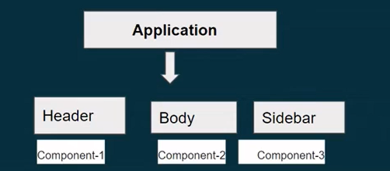
What is Component in React?
Components are independent and reusable bits of code.
They serve the same purpose as JavaScript functions, but work in isolation and return HTML.
Components come in two types, Class components and Function components.

Slide 5
Creating First React.js Application
React installation steps-
Install Node.js and npm
Install VS code
Install React
npx create-react-app my-app - deprecated/outdated
npm create vite@latest

Slide 6
What is JSX?
JSX stands for JavaScript XML or Extension.
With the help Of JSX we can write and add HTML-like code in React.
JSX converts HTML tags into React element with the help of babel library.
It’s not compulsory to use JSX.
Rules of writing JSX
Html must wrap into one top level element.
Elements must be closed.
Attribute class = className
NO if else condition inside jsx but ternary operator is Okay.
JS expression in JSX must be wrapped in { }.

Slide 7
JSX Syntax:
const element = (
<div className="container">
<h1>Hello, world!</h1>
<p>This is JSX syntax.</p>
</div>
);
React Elements:
const element = React.createElement('div',
{ className: 'container' },
React.createElement('h1', null, 'Hello, world!'),
React.createElement('p', null, 'This is JSX syntax.')
);

